Slide 1
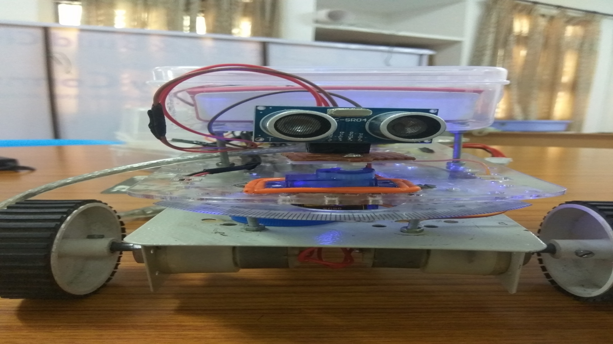
SMART AUTONOMOUS VEHICLE
TO NAVIGATION AND DATA ACQUISITION
150040495

Slide 2
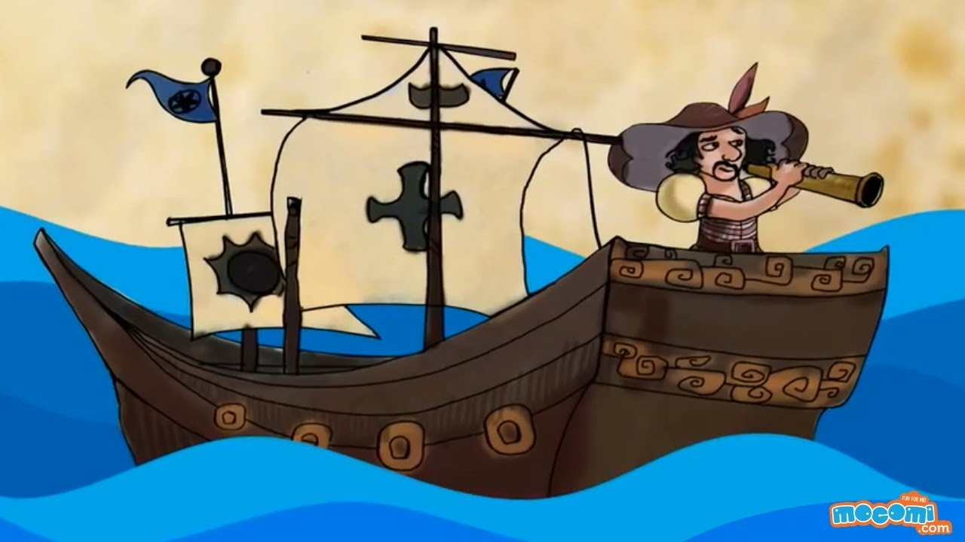
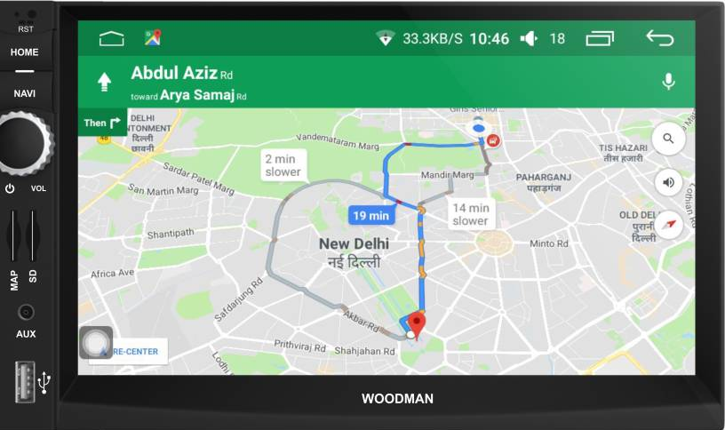
What is navigation and why we need to navigate?
What if we automate this system? Is it ever happened before? If so, what advantages it brought to the society?

Slide 3
What is Data acquisition and we need it?
Data is information
Here we mainly deals with sensors data and store them to apply further processing.
The data may be analog or digital.
Some of the example of data are
Temperature of the room
GPS points
Nitrogen content of the soil
Cell count of the blood
LIDAR data.

Slide 4
Why we developed this autonomous rover?
To automate the process of soil sampling and to improve the health of the agricultural field by acquiring the basic parameter like
Moisture
Temperature
Air quality
Humidity
Soil nutrient contents like nitrogen, potassium.
We also compare the results with our database and judge whether the soil is in good condition to a specific crop. If not, we suggest the farmer to improve the health of the field.

Slide 5
Technologies we are using to achieve our goal
Machine learning
Artificial neural networks
LIDAR
Global positioning system
Google maps

Slide 6
How we navigate autonomously?
We use machine learning algorithm SVM where train the rover to navigate autonomously.
For example we take distances at every 30 degrees angle of the ULTRA SONAR. And class denoting the state of the rover.
We consider four states to the rover
State 1: forward
State 2: backward
State 3: right
State 4:left

Slide 7
Sample distance vectors and corresponding classes

Slide 8
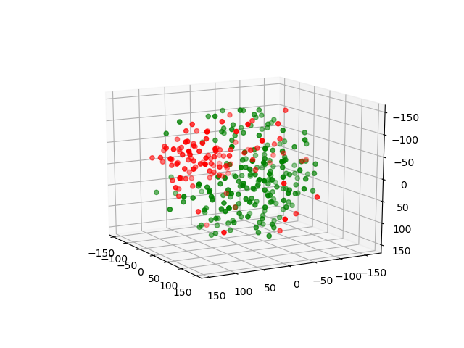
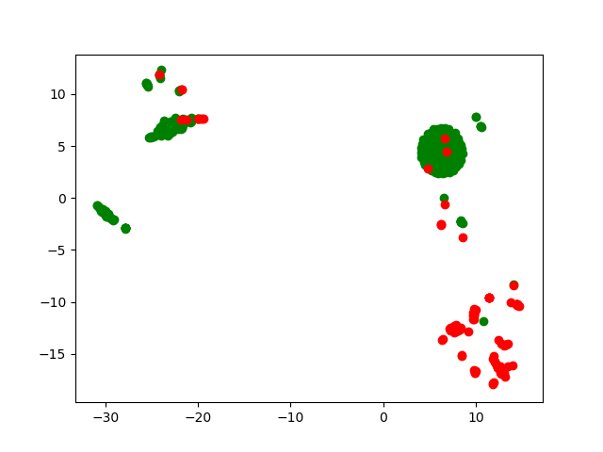
Data visualization using dimensionality reduction

Slide 9
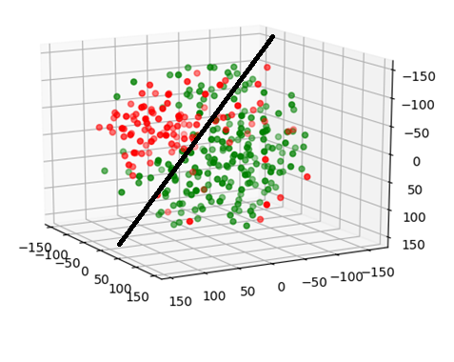
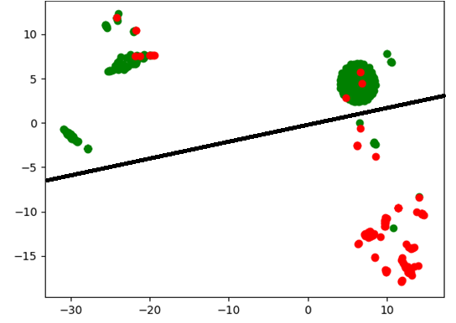
SVM creates hyper plane to separate the classes

Slide 10
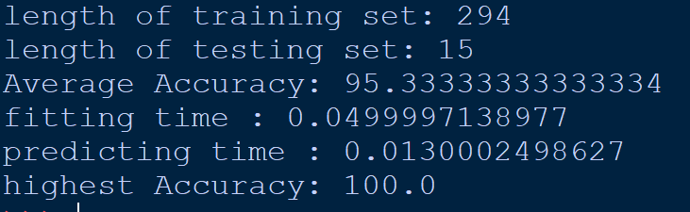
Training and accuracy of prediction

Slide 11
Other alternate algorithms we can use:
Naïve Bayes
Random forest
KNN
Neural networks
PCA for dimensionality reduction

Slide 12

Rover bogie mechanical design

Slide 13
Lets go with live demo to understand in depth

Slide 14
Lets take a look at data we have collected during last run of the rover

Slide 15
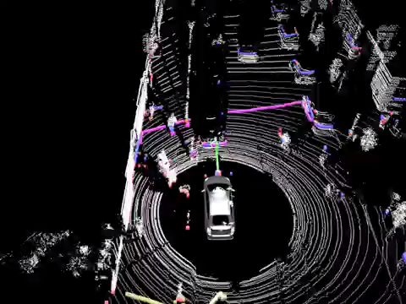
Alternate real time applications

Slide 16
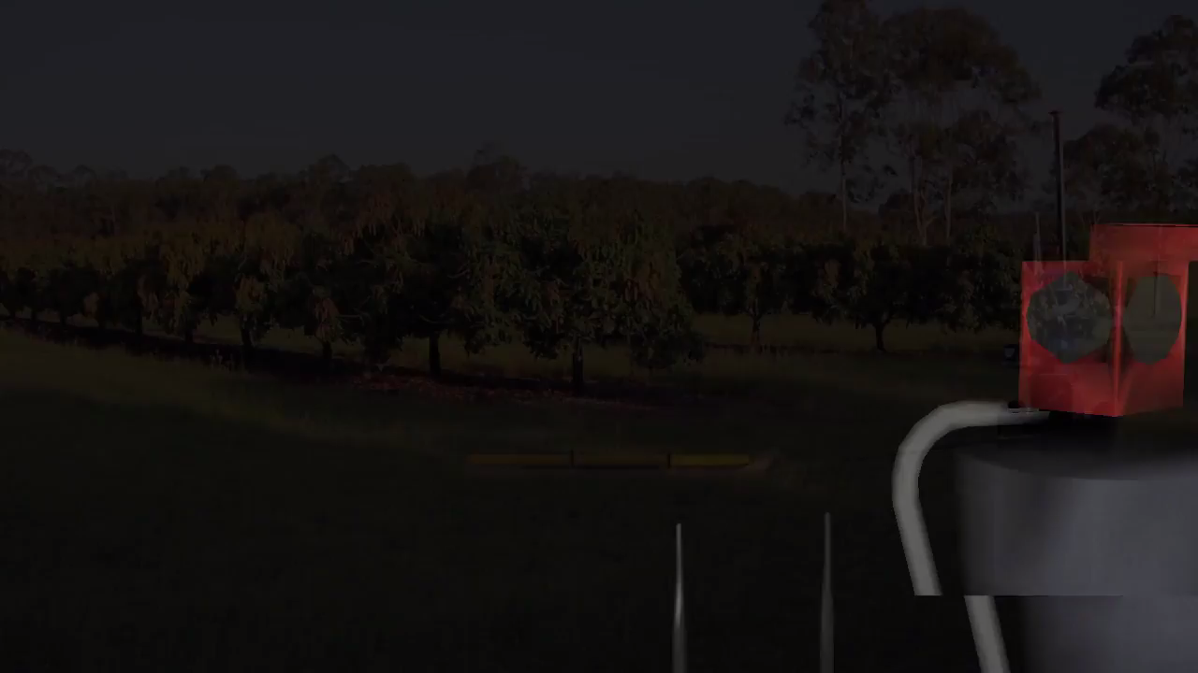

Slide 17
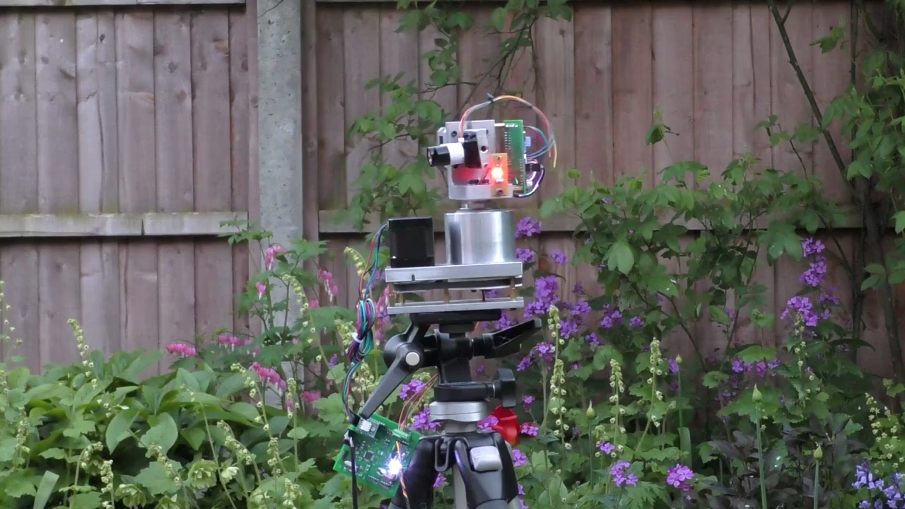

Slide 18
THANK YOU

